Slide 1

Reducing Caregiver Resistance by using Motivational Interviewing Skills
Mary Schrier, MA, BCBA, LBA
Autism Supervisor
Community Mental Health for Central Michigan

Slide 2

What You will Learn
How to Improve Rapport, Reduce Resistance, and Lead to Change
What is Motivational Interviewing
The Spirit of MI
Four Tasks in MI: Engaging, Focusing, Evoking, Planning
MI Basic Skills -- OARS
Tools to Use Today
BACB Test Content Outline (6th ed.) E8: Identify and apply interpersonal and other skills to establish and maintain professional relationships.

Slide 3
How does parent resistance show up?
”We do things our own way.”
Cancelling Parent Training sessions
“Forgetting” to use PECS book
“We already tried that.”
Not collecting data -- “I don’t have time for that.”
Telling the tech “this won’t work”
“She listens to me at home. We don’t see any problems.”
What are your examples?
How do you typically respond?
Notes:
“Resistance” often is used by clinicians to blame and explain non-compliance and opposition.
What do we do as clinicians? Often avoid the uncomfortable conversations.
What can we do? Communicate with an open-mind and compassion to find the function of the resistance.

Slide 4

“Parent resistance in ABA services is one of the most frequently cited challenges by behavior analysts, yet it is often misunderstood.
The default assumption that resistant parents lack motivation or concern about their child's progress misses a more nuanced and productive explanation: parent resistance frequently reflects a mismatch in communication between the practitioner and the caregiver.” Plattner & Anderson, 2023

Slide 5
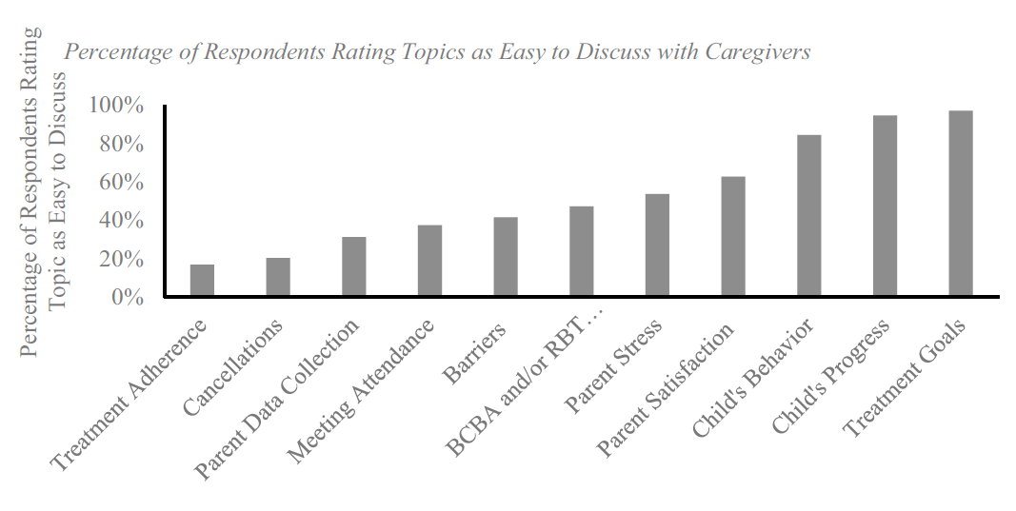
Surveys of Parents and BCBAs Both Report Challenges to Joint Communication
Parents reported BCBAs lack interpersonal skills of:
Listening & collaborating
Empathy & compassion
Approach to their work
Taylor, B. A., LeBlanc, L. A., & Nosik, M. R. (2018).
Plattner, C. & Anderson, C. (2023).

Slide 6
Therapeutic Alliance
Relationship between A clinician and client
Develop
Develop mutual trust and emotional bond.
Set
Together set goals for treatment and agree on interventions to reach them.
Check
Regularly check for satisfaction with the plan.

Slide 7
Benefits of strong Therapeutic alliance
Follow interventions and recommendations
Client satisfaction
Better clinical outcomes
Notes:
Yet many BCBA’s were not formally trained in these communication skills during grad school or even their supervision hours.

Slide 8
Motivational Interviewing
Motivation: Reason for doing something
Interviewing: Guidance to bring forth the motivation
Motivational Interviewing has been defined as a way of “talking with people about change and growth to strengthen their own motivation and commitment.” (Miller & Rollnick, 2023, p. 12).
MI is about evoking motivation to change or grow.
Notes:
MI is an evidence based approach used in many fields that enhances the therapeutic relationship and alliance.

Slide 9
MI reduces resistance
Decades of research shows that using Motivational Interviewing leads to:
Increased engagement in planning for interventions and implementation
Better follow through of treatment recommendations
Less drop out

Slide 10
The guiding Spirit of Motivational Interviewing
Partnership:
Collaborate with client’s own expertise
Acceptance:
Communicate worth, empathy, affirmation & encourage autonomy.
Compassion:
Prioritize client’s needs & welfare
Empowerment:
Elicit personal motivation to change
Instead of trying to be the expert, the fixer or the hero; be the companion and guide on the journey of change and growth.

Slide 11

You are a midwife, assisting at someone else’s birth. Do good without show or fuss. Facilitate what is happening rather than what you think ought to be happening. If you must take the lead, lead so that the mother is helped, yet still free and in charge. When the baby is born, the mother will rightly say, “We did it ourselves!”
-- Lao Tzu, Tao Te Ching
Notes:
The goal of MI is not to convince or persuade but to help the individual discover and articulate their own reasons for change.

Slide 12
Four Fundamental processes of MI
ENGAGE:
Build Therapeutic Alliance
FOCUS:
Clarify Goals
EVOKE
Elicit Change Talk
PLAN:
How to Change
Not linear; more like stairsteps to go up or down.

Slide 13

ENGAGE
Begin the therapeutic alliance.
Empathetic listening to establish a nonjudgemental human relationship.
MI experts recommend about 20% of your time together is spent engaging, especially in the beginning of the relationship.
Skip the “Let’s Get Down to Business” instead ask permission to Walk Together.
People don’t care how much you know until they know how much you care. -- John Hanley

Slide 14

focus
Where Are We Going?
Clarify:
What changes person might make
  Straightforward goals
  Path with longer term objectives
  Clarifying from general concerns
Who wants this change to happen
  Make sure you are moving Together
  “What would you like to do for yourself?”

Slide 15
EVOKe
Ambivalence is a normal response when considering to make changes.
Use OARS (Open-ended Questions, Affirmation, Reflection, and Summarization) to help move toward Change Talk.
Identifying their values can help them discover their motivation of change.
The Why of Change

Slide 16
Oars
Open-Ended Questions invite people to talk to you.
Affirmations genuinely acknowledge strengths and past successes.
Reflections mirror back to show you understand what was said or give an opportunity to be corrected.
Summaries pulls it all together, affirming what was said & discovered.

Slide 17

plan
Where Are We Going?
Transition to How
Evoke and Negotiate a Change Plan
  Use words like willing, consider, possibly, might, try
Evoke hope and confidence
  Confidence Ruler
Brief Action Plan
  Avoid giving directions and prescribing goals

Slide 18
Resisting change
Ambivalence – simultaneously wanting and not wanting to change
  Balance tips back and forth while considering pros and cons
  Choices are not always binary
  Natural response is to defend the other side
Don’t try to persuade or convince a change; their OWN motivation will be stronger than any pro-argument.
To reduce resistance, increase change talk.

Slide 19
Clinicians often come across as saying, “You’re doing it wrong…let me tell you how to do it right.”
often come across as saying, “You’re doing it wrong…let me tell you how to do it right.”
Parents should not be made to feel badly about what they are currently doing; to do so only invites defensiveness and “sustain talk”. When proposing a new intervention, it is critical to not rush or get ahead of their readiness to adopt changes. Instead, build engagement and a sense of collaboration early in the process.

Slide 20
Sustain talk discord
Sustain Talk: statements that indicate reluctance to take on a new behavior, in favor of maintaining the “status quo”.
“To me things are going fine. I am not sure why we need to make any changes.”
Discord: statements indicate a breakdown in collaboration, signals that parents view the situation differently than clinician.
Arguing, interrupting, and negating all represent examples of discord.
Avoiding defensiveness is important; people who aren’t yet motivated to change may be prompted to “defend” the position against change, increasing their motivation to stay the same.
Notes:
Not ready for change. Might be in earliest phase of change -- precontemplative.

Slide 21
Responding to Sustain Talk and Discord
Express empathy, remaining nonjudgmental and respectful
Encourage discussion
Redirect toward shared experiences and goals
Offer validation
Listen empathically and reflectively
Affirm the autonomy of personal choice
Validate concerns and worries using reflective listening or paraphrasing back what is said in a way that conveys understanding

Slide 22
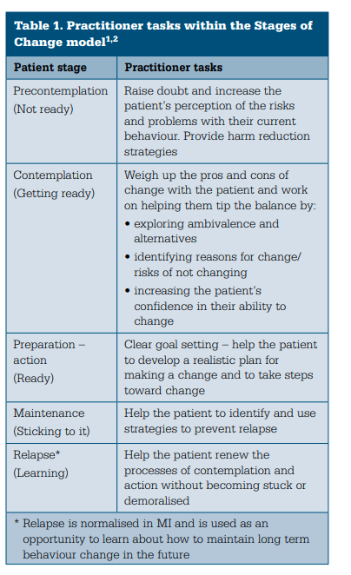
Stage of change

Slide 23

Motivational interviewing tools
Open Ended Questions
“If Any” Questions
Looking Forward/Back
Change Ruler

Slide 24
Open-ended questions
DESCRIPTION | EXAMPLE
Simply ask open questions, the answers to which include change talk. Including “if any” can make the question sound less judgmental. | “How could improving your child’s communication skills make life better for both of you?” “Why is now a good time to work on her sleep habits?” “What concerns, if any, do you have about what you’re doing now?” “What is good/working in your relationship with your son now?” “How is what you’re doing now not working for you?”

Slide 25
Change ruler
DESCRIPTION | EXAMPLE
Rate on a scale from zero to ten how important it is for child to learn this new skill, where zero is not at all important, and ten is extremely important. Anything above a zero means that the person acknowledges something positive about the initiative. | After they give rating ask ” Why did you select that number and not a lower number? e.g. “Why did you select a 3 and not a 1?” Whatever they answer are their reasons for change.

Slide 26
Looking forward or backward
DESCRIPTION | EXAMPLE
Ask how their child might be different if they decide to implement the new intervention, or ask what may happen if they decide to not make changes. | “Suppose you don’t make any changes, but just continue as you have been. How do you picture your child a year from now?”
Ask about previous time when they made a successful change that helped their child grow. How did they do that? Ask for similarities with present situation. | “When was a time when you made changes to the routine that helped your child …?” “What was that like? What did you do to make that change successful? How might those adjustments be helpful now?”

Slide 27
Query Extremes | Ask the parent to describe the worst thing they can imagine if don’t change or to imagine the best things if they do change. | “What are the worst things that might happen if you don’t implement this intervention?” “What are the best things that might happen if you implement the new intervention?”
Exploring Goals and Values | Ask the parent to explore their goals and values about being a parent. that brought them into the work they are doing. Then look for examples where current practices might conflict with their goals and values. Help the person recognize the discrepancy between his/her personal goals/values and current practices. | “I know seeing your child become more independent is very important to you. I would love to show you what we do at the center to her to do more things for herself and give you tips to use at home. What might get in the way of joining in parent guidance sessions, if any?” “When you picture your relationship with her five years from now, what do you hope it’s like?”

Slide 28

Doing motivational interviewing with someone is like entering their home. One should enter with respect, interest, and kindness, affirm what is good, and refrain from providing unsolicited advice about how to arrange the furniture. -- Kamilla Venner

Slide 29
ReferenceS
American Psychiatric Association Foundation. (2024). OARS for Parents & Caregivers Motivational Interviewing Technique. Washington, D.C
Arbuckle, M. R., Foster, F. P., Talley, R. M., Covell, N. H., & Essock, S. M. (2020). Applying motivational interviewing strategies to enhance organizational readiness and facilitate implementation efforts. Quality Management in Health Care, 29(1), 1–6. https://doi.org/10.1097/qmh.0000000000000234
Curtis, L. A., & Clifford, D. (2016). Motivational interviewing in Nutrition and Fitness. Guilford Publications.
Hall, K., Gibbie, T., & Lubman, D. I. (2012). Motivational interviewing techniques - facilitating behaviour change in the general practice setting. Australian family physician, 41(9), 660–667.
Miller, W. R., & Rollnick, S. (2023). Motivational interviewing: Helping people change and grow. The Guilford Press.
Plattner, C., & Anderson, C. (2023). Therapeutic relationships in applied behavior analysis: Current status and future directions. Behavior Analysis in Practice, 16(4), 1222–1230. https://doi.org/10.1007/s40617-023-00819-8
Taylor, B. A., LeBlanc, L. A., & Nosik, M. R. (2018). Compassionate Care in behavior analytic treatment: Can outcomes be enhanced by attending to relationships with caregivers? Behavior Analysis in Practice, 12(3), 654–666. https://doi.org/10.1007/s40617-018-00289-3

