Slide 1
CMHCM Presentation
ABA Provider Quarterly Meeting
Aug. 5, 2026

Slide 2
Updates & Reminders
CIGMMO
  Document Training on IPOS and ABA Plans
  Progress Notes
  Autism Assessments
  Transportation Logs
  Monthly Reports – Training coming soon
Authorization Requests
Family Guidance Priority
Telehealth Services
Key people and resources
Save the Dates for Upcoming Trainings

Slide 3
Document Training
All contracted staff must be trained on the IPOS before initial service and when annual PCP occurs.
  Enter as Attachment to current PCP plan.
All staff must be trained on each ABA plan.
  Enter as Attachment to current Autism Assessment.
Behavior Plans also need a separate training and consent

Slide 4
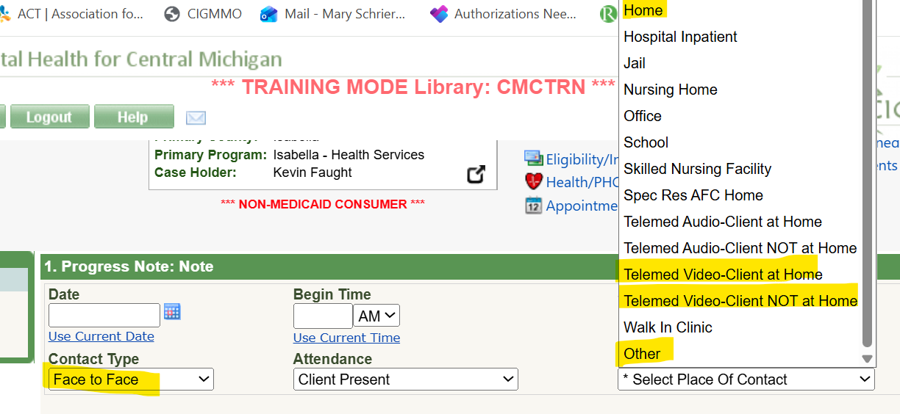
Progress Notes -- Billable
Contact Type MUST be Face to Face, even if it is virtual
Attendance should be either Client Present or Family Present w/o Beneficiary
Place of Service
  Home – consumer in home; clinician in home
  Telemed Video-Client at Home – consumer in home, clinician on video
  Telemed Video-Client NOT at Home – consumer not at home (at center), clinician on video
  Other -- consumer at center; clinician in person at center

Slide 5
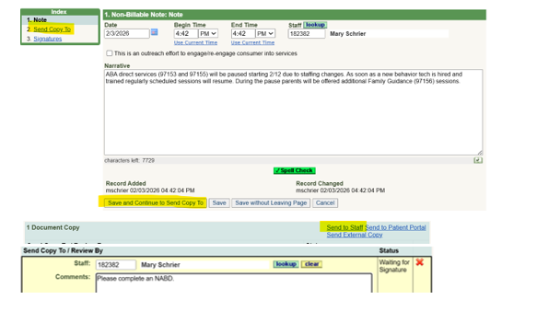
Progress Notes -- Non-billable
Non-Billable Progress Notes should be entered to document reasons for when services are not provided as authorized in the Person Centered Plans.
DIRECTIONS: Enter a non-billable note with the details. Before signing the note go to the Send Copy To page. Use Lookup for Case Holder name and add comment to “complete NABD.” This will create a To-Do Item.
If non-clinician needs access to enter the notes please complete a new CIGGMO Access Request form, select Autism Administration and email to Amanda Shanabrook.

Slide 6
Autism Assessment Entry Requirements
Autism Assessments must be completed prior to start of services and at least every six months in order to bill for this service and auths to be added.
  They need to be uploaded into the consumer chart under Autism Assessment in the purple section of CIGMMO.
  Needs to include the total direct and indirect time spent on the assessment and plan
  Include the school and ABA schedules
    Reminder ABA can’t supplant education
  Date of assessment must be the final date that will be billed.
  Entry needs to be signed by the providing clinician
  Plan must be current (within the past six months)

Slide 7
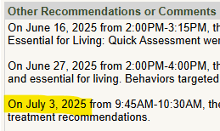
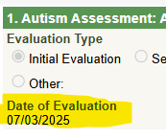
Example:
Under “Other Recommendations or Comments” enter the dates and times that were spent on the attached assessment.
The date of the assessment should match the FINAL date it was worked on.

Slide 8
Monthly Reports – New Requirement Coming
As of 10/1/26 ABA Clinicians will need to complete Autism Monthly Reports in each Consumer’s chart in CIGMMO.
A mandatory training is planned for Friday, Sept. 11. If your clinicians are not able to attend they will need to watch the recording before October 1.
Transportation logs need to be completed and uploaded to the Monthly Report tab in CIGMMO for any consumers being transported by the provider, even if transportation time is not billed to CMHCM.

Slide 9
Requesting Authorizations
Email request form to ABATeam@cmhcm.org at least 2 weeks prior to starting schedule.
  Request form needs to include ABA and school schedules and is signed by parent.
  If requesting in CIGMMO please ALSO send email to ABATeam@cmhcm.org alert that a change is needed with the date that you would like the new auths to start.
Requests to change auths to accommodate fall schedules should be sent at least 3 weeks in advance, with “Fall Schedule” in subject line.

Slide 10
Auths Prior to Services; Without Services
Prior to providing any services it is the provider’s responsibility to make sure the auths are available and accurate.
CMHCM cannot backdate auths.
If there is an error contact the Autism Team (ABATeam@cmhcm.org) and the case holder BEFORE providing services so it can be corrected.
If consumer’s services are changing, going on hold, or utilization is low, please email the ABA Team and case holder as soon as possible to try to resolve issues. We are required to send a notice whenever authorized services are reduced, stopped or paused, so communication is imperative.

Slide 11
Family Guidance Priority
Expectation is for providers to begin Family Guidance as soon as possible after completing the initial evaluation.
  First session should be scheduled when meeting with family at assessment.
  Should be provided at least 1 hour per month
  Auths are entered for this frequency when initial auth is added; more units can be requested
Save the Date for Sept. 17, 1-3 pm for a virtual training on MidState’s Best Practices for Family Guidance document. CEUs will be provided.

Slide 12
Telehealth Reminders
Clinician and consumer both need to be on camera when Telehealth services are provided.
  If unable to maintain video contact you can schedule one unit if at least 8 minutes were provided via video. Reschedule and/or troubleshoot alternative solutions for the next session.
Telehealth should only be provided when
  There is a clinical benefit to the consumer
  Service can be effectively provided using virtual technology
  Consumer and family have consented to telehealth prior to service
Telehealth must be in the best interest/preference for the consumer and is not merely for provider convenience.

Slide 13
Key CMHCM resources
Providernetwork@cmhcm.org: Contract and Credentialing questions
ABATeam@cmhcm.org: Auth requests, Assessment questions, Referrals, CIGMMO access
Payables@cmhcm.org: Questions regarding billing and batches
Case Holders: Annual training on IPOS and prior to first service; Contact between you and family
Incident Reports: Email to adminclerical@cmhcm.org
Communication is key! Please remember to reach out with challenges reaching family, services are going on hold, auths are not in, & other questions.

Slide 14
Upcoming Virtual Trainings
Sept. 11, 2026, 3-4 pm -- MANDATORY – CIGMMO updates including Monthly Report entries
Sept. 17, 2026, 1-3 pm -- MidState’s Best Practices for Family Guidance document. CEUs will be provided.
Nov. 4, 2026, 10am – Quarterly ABA Provider Meeting -- Training Topic will be Assent with Guest Presenters from Finni

