Slide 1
Incident Reports & Critical Incident Analysis
Presented by:
Jane Gilmore- ORR and
Karen Bressette-Provider Network

Slide 2
When to Complete an Incident Report
Abuse or Neglect is apparent or suspected*
ANY violation of a right protected by the Michigan Mental Health Code (MMHC) is apparent or suspected**
A consumer has been sexually abused, sexually assaulted, or abducted by someone other than staff
Death
Choking
ER/Urgent Care visit due to serious illness
Hospitalization due to serious illness (an unscheduled admission not due to chronic illness or underlying condition)
A consumer is injured and goes to ER/Urgent Care
A consumer is hospitalized due to injury
A fall results in injury, or is so serious that an injury is likely to appear later
Traffic accident
Medication error
Medication error that requires an ER/Urgent Care visit

Slide 3
When to Complete an Incident Report
Medication error that results in hospitalization
Medication problem: any missed or delayed dose due to circumstances beyond the med passer’s control that is not covered by a protocol
Medication refusal (including spitting out) when the medication is not ultimately taken
Arrest
Challenging behavior not addressed in Person-Centered Plan
Unauthorized leave
Emergency physical intervention
PRN medication given in response to challenging behavior
Staff called police about challenging behavior
Self-harm by a consumer that requires an ER/Urgent Care visit
Self-harm by a consumer that results in hospitalization
A consumer harms another person, who requires an ER/Urgent Care visit
A consumer harms another person, who is hospitalized

Slide 4
When to Complete an Incident Report
*Note that a staff person who learns of apparent or suspected Abuse or Neglect must make an immediate verbal report to a Supervisor and to the CMHCM Office of Recipient Rights (CMHCM ORR), and complete an incident report before their shift is over.
**Alleged violations of other rights protected by the MMHC must be promptly reported by staff to a Supervisor and to the CMHCM ORR, and staff must complete an incident report before their shift is over.
Fax: 989-773-1968 or E- Mail rights@cmhcm.org

Slide 5
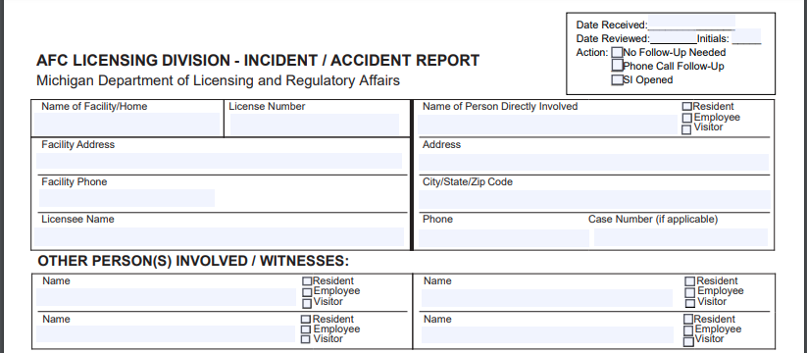
Completing the top section of the IR
Notes:
In the upper right-hand corner, fill in the recipient’s first and last name, his/her case number, age, birth date, and sex.
Fill in the report date (the day you wrote the report) and time.
Fill in the name of the agency you work for (e.g. Listening Ear, Personal Assistance Options, Valley Residential Services).
Fill in the name of your worksite (e.g. Mt. Pleasant AFC, Reed City AFC).
Fill in the date and time when you discovered the incident, when it happened, and where it happened (be specific).
Fill in the first and last initials of other recipients involved or present. Alternatively, you can use other recipients’ first names or first name and last initial.
Use the full names of any employees involved and/or present.

Slide 6
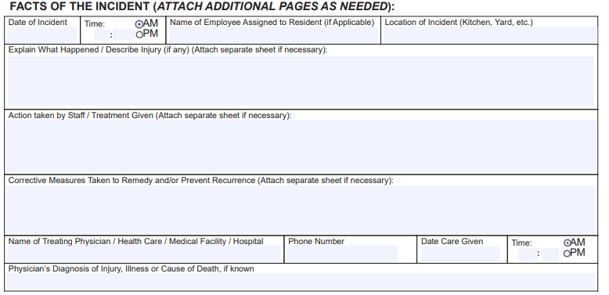
Just the Facts….
Notes:
When describing the incident, explain in simple terms what happened. Be clear and specific. If other recipients were involved in the situation you are describing, use only their initials or first names.
Action taken by staff: Describe what you did in response to the incident. Describe what you did to prevent another, similar incident from occurring. Check “yes” or “no” to indicate whether signs of an injury were present.

Slide 7
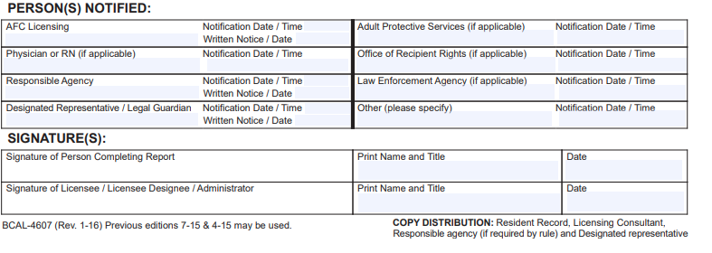
Finishing the Report
All Incident Reports (IRs) must be sent to CMHCM (to the Office of Recipient Rights and to the Recipient’s Case Manager, if applicable) no later than the next business day following the incident described. IRs can be dropped off at or mailed to CMHCM/Mt. Pleasant, or faxed.* email rights@cmhcm.org
Notes:
Note:
LICENSING RULES FOR AFC SMALLAND LARGE GROUPHOMES R 400.15311 Investigation and reporting of incidents, accidents, illnesses, absences, and death.
LICENSING RULES FOR AFC FAMILY HOMES R 400.1416 Resident health care.
R 400.1417 Absence without notice.
LICENSING RULES FOR AFC CONGREGATE FACILITIES R 400.2404 Illnesses and accidents
R 400.2405 Deaths of Residents.

Slide 8
Critical Incident Analysis Forms
A Critical Incident is a serious/potentially serious event that occurs while a consumer is receiving services from CMHCM or a contracted provider. Such an event requires close examination, with the goal of identifying factors that contributed to the event and making it less likely future, similar events will occur.
If the IR describes a Critical Incident:
Home Manager (for residential settings) or Supervisor (for other settings) should indicate on the IR that a Critical Incident Analysis form will be completed and submitted.
Recipient Rights Advisors (RRAs) and/or Case Managers will be contacting Home Managers and Supervisors when IRs describing critical incidents are received, if there’s no indication a Critical Incident Analysis form is forthcoming.
Home Manager or Supervisor must complete the Critical Incident Analysis Form. S/he may wish to consult with the staff person who completed the initial IR. The Home Manager or Supervisor should describe factors that contributed to the incident and ways of preventing future incidents related to:

Slide 9
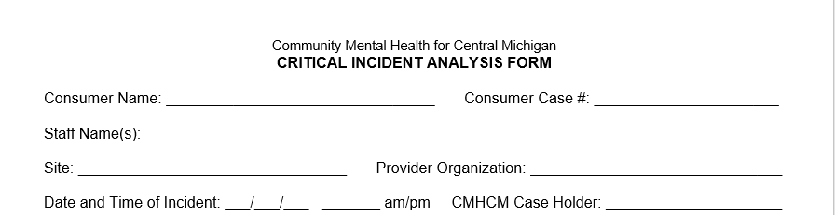
Critical Incident Analysis- Completing the Form

Slide 10
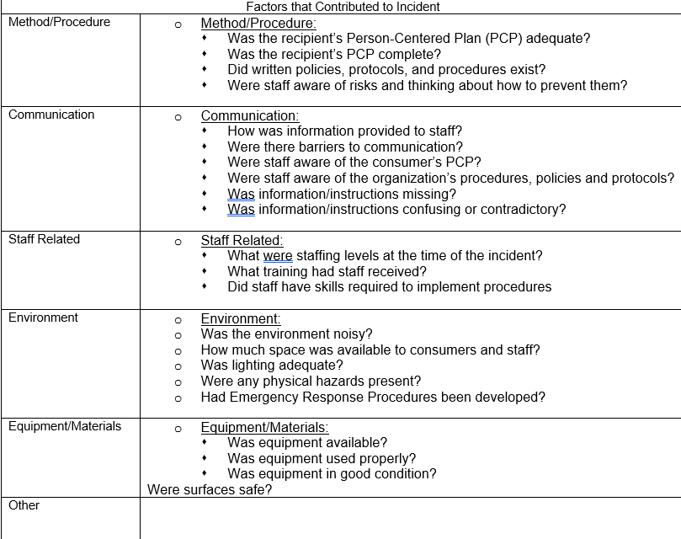
Describe factors that contributed to the incident:

Slide 11
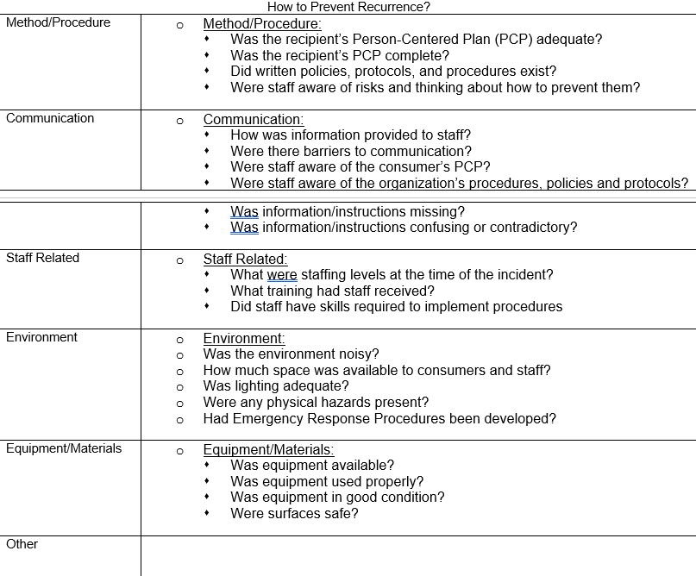
How to Prevent Reoccurrence?

Slide 12
Send a Copy To:
SEND A COPY OF ALL INCIDENT REPORTS TO CMHCM OFFICE OF RECIPIENT RIGHTS WITHIN 24 HOURS OF INCIDENT. E-mail or Fax
SEND COMPLETED CRITICAL INCIDENT ANALYSIS FORM TO:
CMHCM Sentinel Events Review Committee (SERC)
C/O Secretary for Recipient Rights Dept.
301 S. Crapo St., Suite 100, Mt. Pleasant, MI, 48858.
Fax: 989-773-1968 E- Mail rights@cmhcm.org
WITHIN 30 DAYS OF INCIDENT

Slide 13
??????????????????????
Questions?

