Slide 1
Behavior Treatment Committee

Slide 2
What is
Behavior Treatment Committee?

Slide 3
The BTC is a specially constituted committee appointed by the executive director whose purpose is to review and approve or disapprove any Behavior Plans that propose to use restrictive or intrusive interventions with individuals served by Community Mental Health for Central Michigan who exhibit seriously aggressive, self-injurious or other challenging behaviors that place the individual or others at imminent risk of physical harm.
BTC is composed of:
BTC Chairperson
Clerical Staff
Behavior Services Team
Clinical Supervisors (typically one supervisor from each county)
Medical Director and Administrative Nurse
Recipient Rights rotating representative (non-voting member)

Slide 4
Interventions that require BTC prior approval
Intrusive interventions: Techniques that encroach upon the bodily integrity or personal space of the individual for the purpose of achieving management or control (e.g., enhanced staffing, medications for behavioral control)
Restrictive interventions: Techniques that result in limitations of the individual’s rights used for the purpose of management or control (e.g., restricted access to sharps, limited access to internet)

Slide 5

Interventions that do not require BTC prior approval
General positive behavioral supports (e.g., incentive programs, skill development)
Intrusive/restrictive interventions needed in an imminent risk situation
Behavior Treatment Policy 2-200-001

Slide 6
Emergency Review Process
BTC can approve restrictive/intrusive interventions on an emergency basis for unprecedented and unpredicted occurrences of seriously aggressive, self-injurious, or other behaviors that place the individual or others at risk of harm
CMHCM case holder proposes interventions (e.g., enhanced staffing, restricted access to area of home) within the Individual Plan of Service (IPOS) and requests BTC review
BTC assesses whether:
  There is evidence of significant risk to the individual or others
  Less restrictive interventions were attempted and were unsuccessful at reducing risk
  The proposed intervention is likely to reduce the safety risks

Slide 7
Standard Review Process
The BTC shall:
Review plans and behavioral data to assure that an intervention is necessary; that the intervention is the least restrictive effective intervention; and that the rights of the individual are protected.
Disapprove any Behavior Plan that proposes to use aversive techniques, physical management, or seclusion or restraint in a setting where it is prohibited by law or regulations.
Determine whether causal analysis (Functional Behavioral Assessment-FBA) of the behavior has been performed, whether positive reinforcers have been identified and behavioral supports and interventions have been adequately pursued, and where these have not occurred disapprove any proposed plan for utilizing intrusive or restrictive techniques.

Slide 8
Behavior Treatment Plans submitted for review must include:
A functional behavioral assessment including baseline data of the target behaviors and the method of data collection
Evidence that the plan was developed as part of the person-centered planning process utilizing input from the individual, guardian, parent of a minor child or designated patient advocate
Results of assessments performed to rule out relevant physical, medical, and environmental causes of the challenging behavior
Results of inquiries about any medical, psychological or other factors that might put the individual subjected to intrusive or restrictive techniques at high risk of death, injury or trauma
Evidence of the kinds of behavioral supports or interventions, including their amount, scope and duration that have been attempted to ameliorate the behavior and have proved to be unsuccessful prior to consideration of any intrusive or restrictive interventions
Positive reinforcement of adaptive/replacement behaviors
Evidence of continued efforts to find other options
Peer reviewed literature or practice guidelines that support any proposed restrictive or intrusive interventions
References to the literature should be included, and where the intervention has limited or no support in the literature, why the plan is the best option available. Citing of common procedures that are well researched and utilized within most behavior treatment plans is not required
A fading plan for any proposed intrusive or restrictive interventions
The plan for monitoring and staff training to assure consistent implementation and documentation of the intervention.

Slide 9
What happens after BTC approves restrictive/intrusive interventions?

Slide 10
AFTER BTC APPROVAL, BEFORE IMPLEMENTATION
Behavior Plan Special Consent must be signed by consumer (or guardian if appointed)
IPOS is updated to state that the consumer has an approved behavior plan being monitored by the BTC team. Additionally, any dedicated staffing is outlined in the IPOS interventions (1:1, line of sight, etc.)
Staff must be trained on the interventions prior to working with the consumer and training must be documented in CIGMMO. The “train the trainer” model is accepted; however, ideally as many staff as possible are trained directly by the plan author

Slide 11
DURING IMPLEMENTATION
Case holder requests consultation from Behavior Services Team if interventions were approved on an emergency basis
Provider continues collecting data on the frequency of target behaviors and effectiveness of interventions and submits to CMHCM at least monthly
Case holder and Behavior Services Team (if involved) monitor the fidelity of implementation at least monthly
BTC reviews the interventions at least quarterly
Interventions are adjusted as needed (any changes to restrictive/intrusive interventions need new BTC approval)
Document continued efforts to find less restrictive options

Slide 12
What is the
CMHCM Behavior Services Team?

Slide 13
Specialized behavioral assessment, consultation, and intervention
Provides additional support to consumers exhibiting seriously aggressive, self-injurious, or other challenging behaviors that place the individual or others at risk of severe harm
Works alongside providers, BTC, and treatment teams; cannot approve restrictive/intrusive interventions without BTC
Madison Chapman, PhD, LP
Lead Clinical Psychologist
Deb Grossett, PhD, BCBA-D, LBA, LP
Psychologist
Katie McGillis, MS, TLLP
Psychology Intern (soon to be Psychologist)
& graduate students from
Central Michigan University

Slide 14
How can the
CMHCM Behavior Services Team assist?

Slide 15
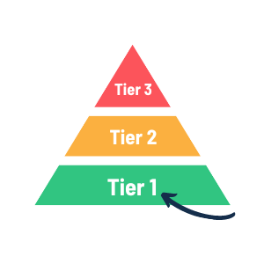
PREVENTION
Training
Provide resources for positive behavior supports and interventions
AFC Team Meetings
Attend multi-disciplinary teams with CMHCM & providers
Help providers understand BTC requirements and process
Assist with implementing universal positive behavior supports

Slide 16
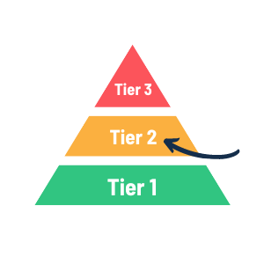
EARLY INTERVENTION
Behavioral Consultation
Develop data collection plans to monitor emerging/mild challenging behaviors
Help staff develop targeted positive support interventions
Work with staff, families, guardians
Monitor implementation and effectiveness of interventions

Slide 17
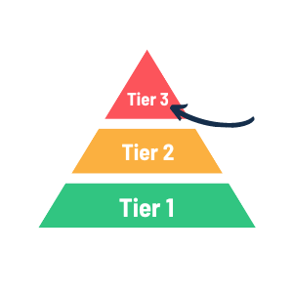
INTENSIVE INTERVENTION
Behavior Treatment Plans
Functional behavior assessment to determine why the challenging behavior is occurring
Develop strategies to teach new skills and help to shift staff response to challenging behaviors to prevent and respond to challenging behaviors
Identify restrictive or intrusive interventions that are necessary to maintain safety
Provide initial and ongoing training
Work toward reducing restrictive and intrusive interventions

Slide 18
How can providers request support?
What is expected of providers?

Slide 19
PRE-REFERRAL
POST-REFERRAL
Define target behaviors and collect data (i.e., how often? patterns?)
Evaluate possible medical causes of challenging behavior
Collaborate with CMHCM case holder to implement and document effectiveness of positive support strategies
Behavior Services Team may request data collection and positive behavior supports continue for a longer period
Consultation meeting to discuss the behaviors and interventions
Evaluate what level of support is warranted (i.e., consultation or Behavior Treatment Plan)
Provider will be expected to continue data collection and implement interventions as written in the plan
REFERRAL
If positive supports were unsuccessful, CMHCM case holder submits referral to Behavior Services Team for support

Slide 20
Questions?

