Slide 1
Using Effective Communication to
Prevent Challenging Behaviors

Slide 2

DISCLAIMERS
It is reasonable to expect that the people with whom you work will experience challenges and, as a result, display disruptive and sometimes unsafe behaviors.
These communication strategies will have varying results depending on the situation.
This probably won't be brand new information to you.

Slide 3

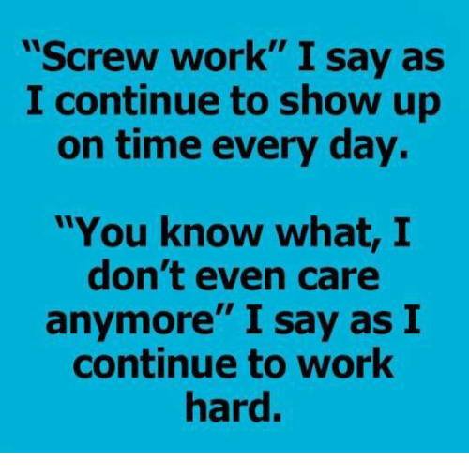
You chose to work with people who often have challenging behaviors in your job...why?

Slide 4
Why did you get into this profession?
Why do you stay in this profession?

Slide 5
Overview of Communication
Behavior = Communication
Everyone communicates through behavior. This communication may be intentional and direct, or unintentional and indirect.
Familiarity enhances our ability to interpret others' communication.
Behavior is even more important in the absence of verbal language.
Effective Communication = Respecting Rights
It can be difficult to balance giving directions/commands while respecting consumers' rights.
However, direct communication can be supportive and respectful.

Slide 6
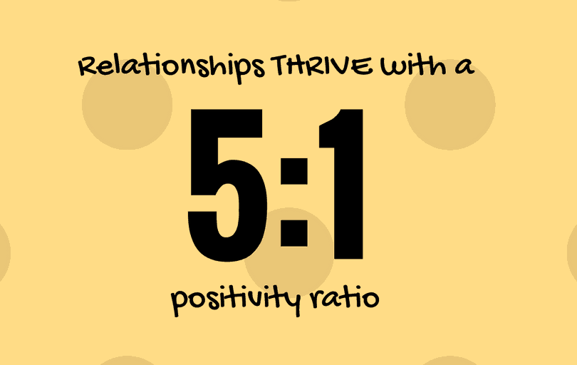
Relationship Building
It’s easier to accept instruction from someone you trust and from someone you have had recent, positive interactions with.
Seek and create positive interactions, especially before giving directions.
Find topics to connect on. Take time to talk about the consumer’s interest.
Give meaningful compliments.

Slide 7
How do you build relationships with consumers?

Slide 8
Communication Strategies
Praise positive behaviors
Offer choices
Provide encouragement and suggestions
Provide rationale for instructions
Give space when needed
Use concrete language

Slide 9


How to…give praise for positives
Give tons and tons of praise for safe and appropriate behaviors.
Look for even small improvements that can be praised.
Use an exaggerated tone to distinguish praise from normal attention, without being patronizing.
Be specific and tell the consumer what they did well.

Slide 10
Examples of Giving Praise
Not quite...
”Great work!”
“Thank you.”
"I'm glad you didn't yell at me this time."
That's it!
“You did a great job putting your dish away!”
“Thank you for telling me you’re upset and need time to yourself.”
??

Slide 11
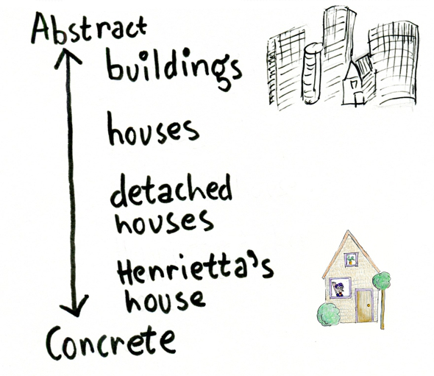
How to…use concrete language
Concrete language is specific and clear
When giving instructions, concrete language helps avoid confusion
Keeps expectations clear
Phrase instructions as what to do rather than what not to do

Slide 12
Examples of Concrete Language
Not quite...
”Please behave in the store.”
“Clean up after dinner please.”
That's it!
“When we go into the store, please keep your hands on the cart.”
??

Slide 13
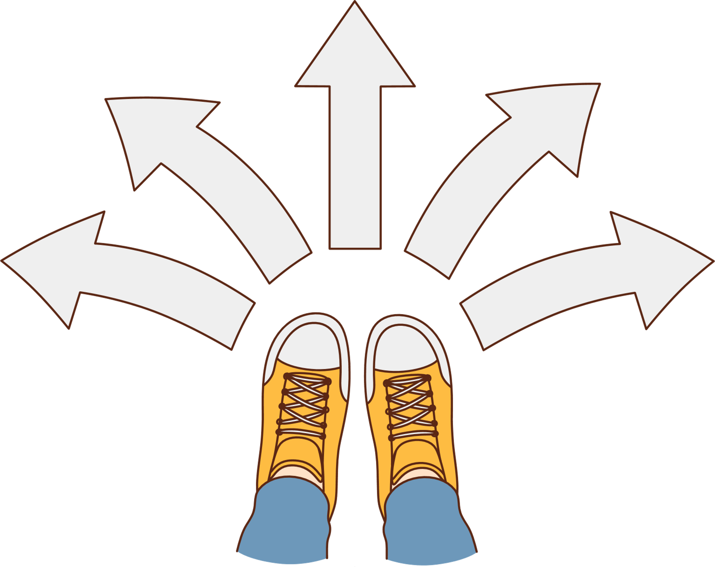
How to…give choices and offer suggestions
Choices promote autonomy and independence
Choices require less critical thinking
Gives the opportunity to remain in control and demonstrate positive behaviors
Choices can lead to the same desired outcome

Slide 14
Examples of Giving Choices
Not quite...
“What would you like to wear today?”
“You should clean your room today.”
That's it!
“Would you like to wear your blue shirt or green shirt today?”
??
Choices can relate to: what, how, when, level of independence, etc.

Slide 15
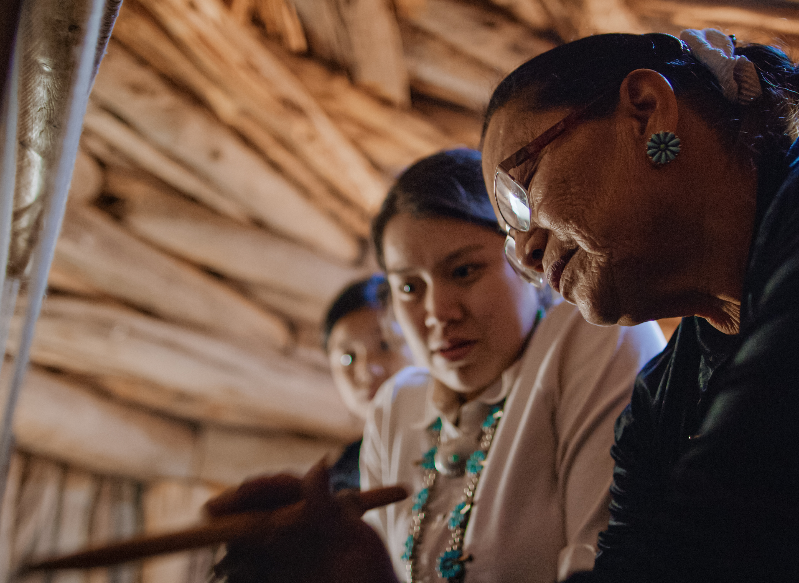
How to…give instructions
Reminder: be concrete, give choices, praise behaviors
Phrase instructions positively, telling the consumer what to do rather than what not to do.
Describe the reason first.
Give one step at a time.
Allow the consumer time to respond.
Give corrective feedback selectively.

Slide 16
What does this mean?
"Don't ever not stop taking your meds."

Slide 17
Examples of Giving Instructions
Not quite...
"It's time to clean up now."
"Thank you for getting ready."
"It's not nice to say that to people."
That's it!
“Do you want to put your plate in the sink now or after you take your meds?"
"We are going to the store soon, please put your shoes on."
??

Slide 18
Giving Instructions Activity
Read each step below carefully. Then follow the instructions.
Type your name in the chat window.
Change your screen by clicking "View" and selecting "Together Mode." On the bottom left, change the scene. Then go back to Gallery View.
Raise your hand, wait 5 seconds, and then lower your hand.
Stop sitting down.
Type your favorite color in the chat, but only if it's blue.
If today is Wednesday, give a thumbs up reaction but count backwards from 10 first.
Type in the chat "I am on number 8" so that we can check our timing.
Do the opposite of what your camera setting currently is.
Once you've read each step carefully, skip steps 2 through 9. Then add a gif or emoji to the chat that represents your current mood.

Slide 19
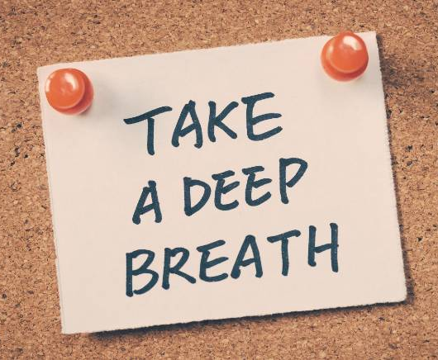
How to…use an effective tone
Speak calmly, respectfully, and give consumers dignity
Respond slowly and patiently
Gentle tones for encouragement
Firm, direct tone in a lower register for safety issues
Use personal coping strategies to regulate your own emotions before accidently responding in a negative tone

Slide 20
Examples of Using an Effective Tone
Not quite...
"Why are you talking to me like that?! I don't know what you want."
"Can you please not grab my neck?"
That's it!
“Kate, can you tell me if you need to go to the bathroom, to eat, or something else?"
??

Slide 21

How to…respond to requests
If the request cannot be completed as asked, tell the consumer what can be done rather than stating the request is denied.
Validate the consumer’s emotions if they are upset by the response.
Answer the questions a couple of times or encourage the consumer to answer the question. Then redirect to another activity/topic.

Slide 22
Examples of Responding to Requests
Not quite...
"No, we can't go to the store."
"Not right now."
That's it!
“We already went to the store today. The next time we go to the store is on Wednesday. Do you want to play your favorite game or watch a movie instead?"
??

Slide 23

How to...respond to early signs of challenging behaviors
Know your consumer:
  Behaviors exhibited when upset
  Desire for space vs. social interaction
  Coping activities and skills
    Engagement or redirection?
  Use direct, firm language
    When necessary

Slide 24
What do are some signs in the people you work with that show they are starting to have a hard time?

Slide 25

How to...set yourself up for successful communication
Check-in!
  What is my mood today?
  How do I tend to communicate when I am in this mood?
  What do I need from my team today?

Slide 26
How do your coworkers set themselves up for success?

Slide 27
Questions?

Slide 28
It’s not what we say.
It’s “HOW” we say it!
Thank you!

