Slide 1
Data Collection

Slide 2




1
2
3
4

Slide 3
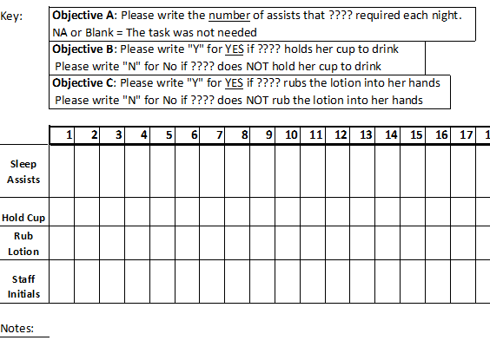
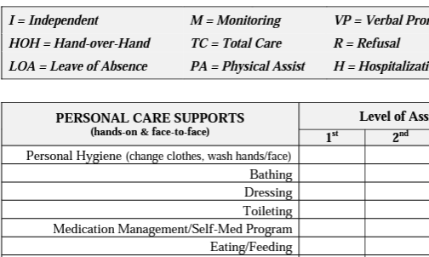
You collect lots of data already!

Slide 4

Expectations for Providers
Data collection is needed when...
There is a significant change in a behavior from baseline
New supports are being considered
Current supports are being monitored
Our goals for data collection are...
To gather information on a consistent basis (daily, weekly, monthly)
To share information with the consumer's entire treatment team
To inform decisions about the consumer's care

Slide 5
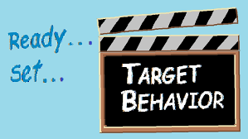
Collecting Behavioral Data: Defining the Target Behavior
Define the target behavior
Generate examples and non-examples
Share with your team!
...What if there are many possible target behaviors?
Choose the ones that are the most frequent/severe and threaten safety

Slide 6
Examples of Target Behaviors
Not Quite...
Yelling
Being Inappropriate

Slide 7
Examples of Target Behaviors
Not Quite...
Yelling
Being Inappropriate
That's It!!
Verbal threats of harm toward staff and others
Sexual touching or acts in public spaces/in front of staff and others

Slide 8
Baseline Behavioral Data
Measurement of the target behavior in its current natural state prior to the proposed intervention.
Questions to Answer
How often is this behavior occurring? Is it an ongoing pattern?
What circumstances lead to the behavior happening? What’s the function?
When/How Long to Collect
Baseline data should be collected for as long as necessary for a reliable pattern to emerge. This might be a period of 2-3 months.

Slide 9
Behavioral Data for Monitoring
Measurement of the target behaviors, new skills, and use of intervention strategies after an intervention is implemented and/or when changes to interventions are proposed.
Questions to Answer
Are the interventions being implemented with fidelity? Is the behavior changing as a result of the interventions? Is the consumer developing new skills? Are the restrictive/intrusive interventions still warranted? When should the interventions be faded?
When/How Long to Collect
Data should be collected for as long as intrusive/restrictive interventions are in place and as long as necessary to inform treatment.

Slide 10
What are some struggles that you (and your staff) have when collecting behavioral data?

Slide 11
Frequency Data
Tracks how often target behaviors occur to provide an accurate rate of behavior.
Can be used to compare data over time.
  Tracking sequential months to see if behaviors are increasing/decreasing.
  Assess if new behavioral trends are emerging.
  Generally assesses the effectiveness of current supports.
Month | Physical Aggression
Jan. Year 1 | 217
Feb. Year 1 | 276
Mar. Year 1 | 124
Jan. Year 2 | 76
Feb. Year 2 | 152
Mar. Year 2 | 53

Slide 12
Frequency Data
Tracks how often target behaviors occur to provide an accurate rate of behavior.
Can be used to compare data over time.
  Tracking sequential months to see if behaviors are increasing/decreasing.
  Assess if new behavioral trends are emerging.
  Generally assesses the effectiveness of current supports.
Month | Physical Aggression
Jan. Year 1 | 217
Feb. Year 1 | 276
Mar. Year 1 | 124
Jan. Year 2 | 76
Feb. Year 2 | 152
Mar. Year 2 | 53

Slide 13
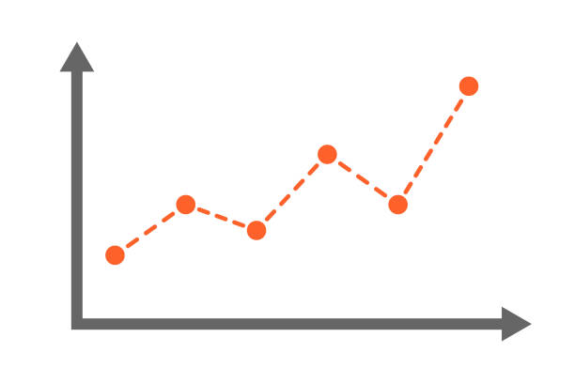
When to Use Frequency Data
To track ongoing target behaviors.
This is particularly important for behaviors that warrant restrictive or intrusive strategies.
  The BTC requires ongoing data to support that limitations of personal rights (via restrictive or intrusive strategies) are still needed.

Slide 14
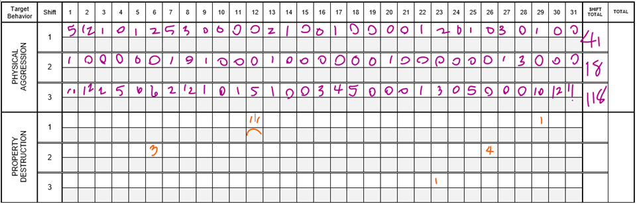
How to Use Frequency Data

Slide 15
How to Use Frequency Data

Slide 16
Antecedent-Behavior-Consequences (ABC) Data
To paint a picture of the behavior and the environment in which it occurs.
  Who is involved in these behaviors?
  What does the behavior look like?
  Where/When is the behavior is more likely to occur?
  What staff responses currently looks like AND the efficacy of those responses.
In other words, it provides us the who / what / where / when / why!

Slide 17
When to Use ABC Data
To create a baseline of behavior.
To identify and investigate possible target behaviors.
Provide insight into environmental and staff factors.
Initiate a hypothesis for why the behavior is occurring.
Help case holders and staff investigate behaviors proactively.
Assess if the behavior has changed.

Slide 18
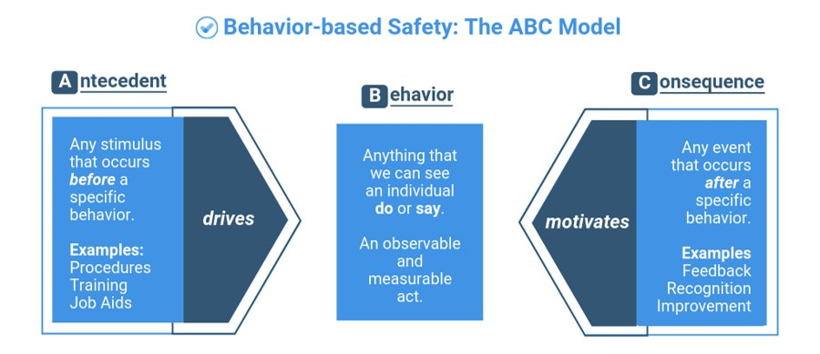
A-B-C Refresher

Slide 19
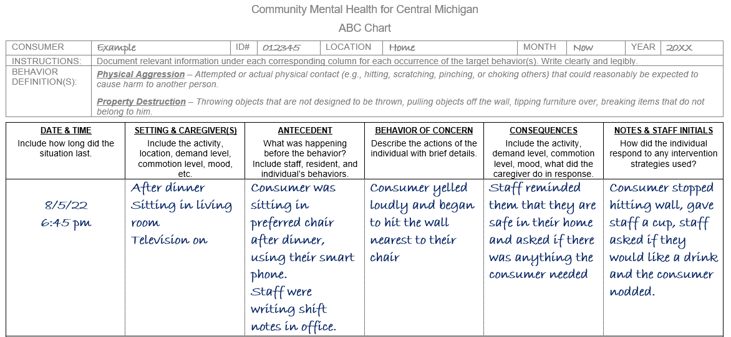
How to Use ABC Data

Slide 20
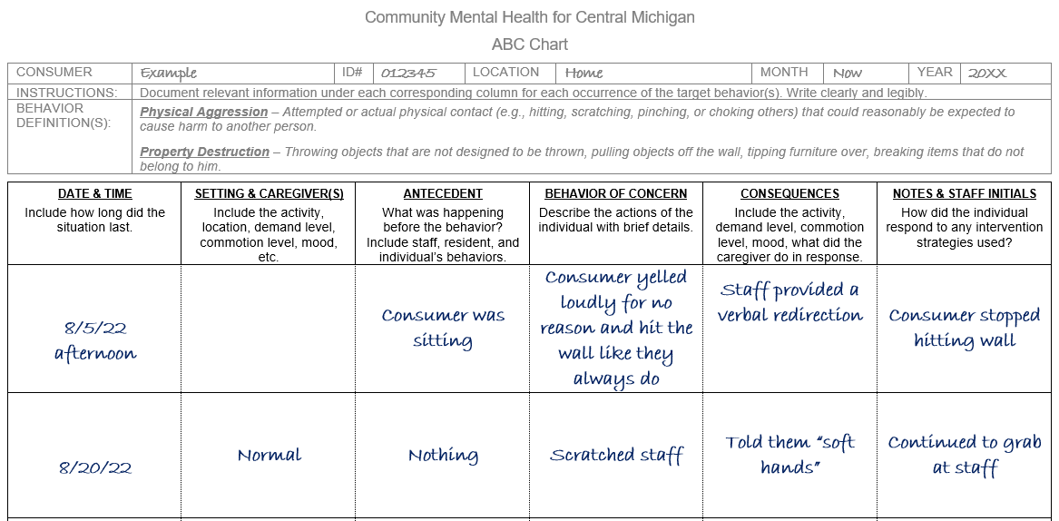
How to Use ABC Data

Slide 21
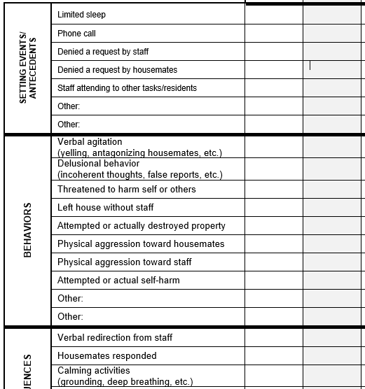
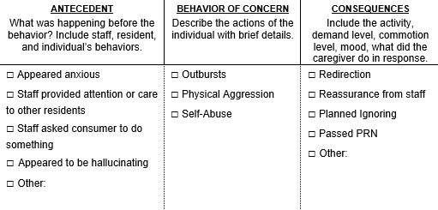
ABC Checkboxes

Slide 22


Purposes of Data Collection
To develop hypotheses about the function of a behavior
Used by psychologists writing behavior treatment plans, behavioral consultation, and ongoing monitoring
Case managers review data and report that to the Behavior Treatment Committee
Decisions are made about restrictive and intrusive interventions based on data collected
Medical providers and support staff may also reference data sheets

Slide 23
An Example of Data Collection
Our consumer is a 22-year-old female with Autism who has been having an increase in physical aggression and property destruction. These behaviors occur at both home and school.
The consumer’s support staff have been asked to begin tracking baseline data to determine potential antecedents and consequences of target behaviors.

Slide 24
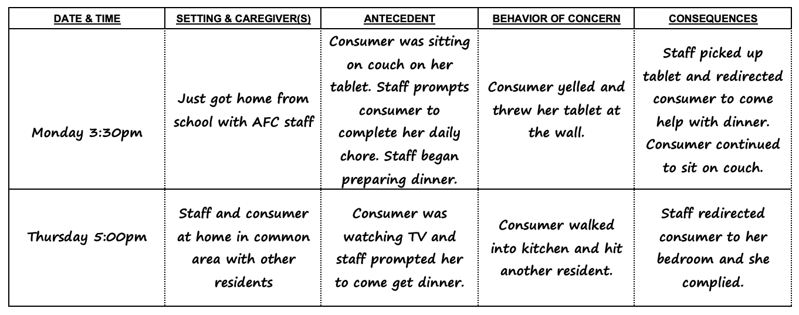
Let’s practice interpreting A-B-C data!

Slide 25
Let’s practice interpreting frequency data!
 | Apr | May | June | July | Aug | Sep | Oct | Nov | Dec | Jan | Feb
Physical Aggression | 12 | 10 | 27 | 34 | 40 | 14 | 10 | 8 | 3 | 2 | 4
Property Destruction | 5 | 3 | 18 | 20 | 25 | 3 | 9 | 10 | 3 | 1 | 0

Slide 26



Let’s practice interpreting frequency data!
 | Apr | May | June | July | Aug | Sep | Oct | Nov | Dec | Jan | Feb
Physical Aggression | 12 | 10 | 27 | 34 | 40 | 14 | 10 | 8 | 3 | 2 | 4
Property Destruction | 5 | 3 | 18 | 20 | 25 | 3 | 9 | 10 | 3 | 1 | 0

Slide 27
What do you find valuable or important about collecting behavioral data?
What successes have you had with data collection?

Slide 28
Questions?

