Slide 1
ABCs of Behavior and
Positive Behavior Supports

Slide 2
What are some concerns or challenges you’ve had when trying to use positive behavior supports?

Slide 3
Myths about Positive Behavior Supports
Incentive programs are just bribes and we shouldn't bribe expected behaviors.
All consumers need to have the same incentive program.
A consumer must have a Behavior Treatment Plan in order to use positive behavior supports.
Data tracking starts after a Behavior Treatment Plan is started.
This is just the way the consumer is, and there's no use trying to change them.

Slide 4
Common Target Behaviors
Aggression (physical and/or verbal)​
Self-injurious behaviors​
Elopement
Medication refusal
Inappropriate sexual behaviors​
Lack of safety skills
It is not uncommon to describe a consumer’s behavior in general terms, like “physically aggressive” or “self-harm”. Although it tells us what the behavior is, it does not help us understand what that looks like. Without clearly defined behavior, it can be difficult to learn more about it – and, ultimately, change it.

Slide 5
Examples: Physical Aggression
Not quite...
Being unsafe
That's it!
Using the body to harm or attempt harm toward others.

Slide 6
Examples: Physical Aggression
Not quite...
Being unsafe
Causing a ruckus
That's it!
Using the body to harm or attempt harm toward others.
When the consumer throws items toward staff.

Slide 7
Examples: Physical Aggression
Not quite...
Being unsafe
Causing a ruckus
Unkind to housemates
That's it!
Using the body to harm or attempt harm toward others.
When the consumer throws items toward staff.
??

Slide 8
Examples: Self-Injurious Behaviors
Not quite...
Self-abuse
That's it!
Harming or attempt harm the self by biting, hitting, slapping.

Slide 9
Examples: Self-Injurious Behaviors
Not quite...
Self-abuse
Self-mutilation
That's it!
Harming or attempt harm the self by biting, hitting, slapping.
Using sharps to cut or scratch arms.

Slide 10
Examples: Self-Injurious Behaviors
Not quite...
Self-abuse
Self-mutilation
Hurts self
That's it!
Harming or attempt harm the self by biting, hitting, slapping.
Using sharps to cut or scratch arms.
??

Slide 11
The Development of “Problem” Behaviors
Modeling (behavior learned from others)​
Regulatory (especially for those with sensory needs)​
Maladaptive coping strategies​
​
Depending on what happens before and after a behavior occurs, the likelihood of that behavior occurring again can be increased or decreased.

Slide 12
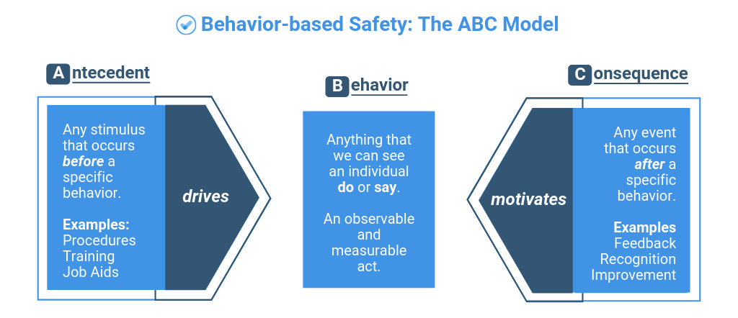

Slide 13
Before and After
Antecedents: Occurs before the target behavior.
Environmental (noise or activity level)
Situational (housemate returns home, or time for the consumer to do laundry)
Internal (negative emotions, physical or medical needs)
Consequences: Occurs as a response to the behavior.
Environmental (elopes from environment or expresses need for space)
Situational (stops doing unwanted task or praised for doing difficult things)
Internal (yelling at others when mad or use a coping strategy)

Slide 14
Other Influences on Target Behaviors
History of trauma
Co-occurring medical conditions
Environmental factors
Communication abilities
Shame / stigma
Signifiant social influences
Impulsivity
Processing grief or stress
Limited problem-solving skills or emotional regulation abilities
???

Slide 15
What are some other factors that could impact behaviors and functioning?

Slide 16
Goals of Positive Behavior Supports
What need is being met by this behavior?
How can that need be met in a safer way?

Slide 17
Common Functions of Behavior
A behavior's function is the reason a behavior continues.
  Escape – avoiding something undesirable
  Attention – gaining social engagement or connection
  Access – gaining access to something desirable
  Sensory – it feels good or removes unpleasant feelings
When a behavior no longer works to serve the function (or when the behavior is no longer reinforced), that behavior will stop and a new behavior will take it's place.

Slide 18
Different behaviors can serve the same function.
The same behavior can serve different functions.
Form of Behavior | Function
Aggression | Escape a demand
Running away | Escape a demand
Talking back | Escape a demand
Self-injurious behavior | Escape a demand
Form of Behavior | Function
Aggression | Escape a demand
Aggression | Get something for self
Aggression | Gain social attention
Aggression | Get something from someone

Slide 19
How do you know if the function is...Escape?
The behavior occurs after a request to perform a difficult or undesired task
It may occur when any request is made of the person
May seem like the person does the behavior to upset or annoy you when you are trying to get the person to do what you ask
Caregivers may remove demands in response to the behavior
The behavior often stops occurring shortly after you stop working with or making demands of the person

Slide 20
How do you know if the function is...Attention?
The behavior seems to occur in response to staff talking to other people or engaging in other tasks
It may occur any time you stop attending to the person
May seem like the person does the behavior to upset or annoy you when you are not paying attention to them
The person seems to do the behavior to get you to spend some time with them

Slide 21
How do you know if the function is...Access?
The behavior happens after the person was told an activity, food, or other item is not available or is taken away
Problematic behaviors are more likely to result in accessing what is desired than other acceptable behaviors
The person usually gets what they want when using this behavior
If the person is given the food, item, or requested activity, the behavior tends to stop

Slide 22
How do you know if the function is...Sensory?
Might happen when the person is alone
Occurs repeatedly, in the same way, for long periods of time
Seems like the persons enjoys doing the behavior because it feels, tastes, looks, smells, or sounds pleasing to them
The person may seem calm and unaware of things in their surroundings

Slide 23
Positive Relationships
Trusting relationships between staff and the consumer helps the consumer and staff work collaboratively toward goals.
  Helps to consider the consumer's own insights into their behavior.
  Consumer's that trust staff are more likely to seek assistance.
  Many behaviors develop to keep the person safe or meet their care needs. Developing positive relationships with staff helps show the consumer they can be safe and have their needs met, without needing to use old strategies.
Learning new ways to meet our needs can be difficult – having support can help with things are challenging.

Slide 24
Planned Ignoring
Planned ignoring is a form of behavior change where behaviors we want to reduce are purposefully not given attention
  This does not mean that we are ignoring the consumer or their needs!
Staff should provide an alternative for the consumer to express their need/want (e.g., communication board or phrase to tell staff) and meet that need when the consumer uses that strategy, while proving less attention to the behavior we do not want to see.

Slide 25

CAUTION
Once you start changing the response to an attention-maintained behavior, be prepared for an "extinction burst."

Slide 26
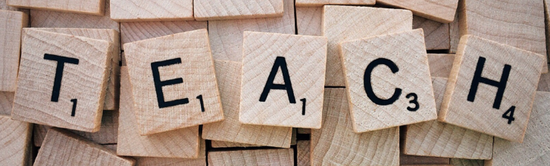
Teach a New Skill
Find the skill that is missing, teach it to the consumer, model how to use it, practice it, and give praise.
Examples:
  Emotional regulation skills
  Communication board
  Visual schedule
  Verbal and nonverbal communication to request a break

Slide 27
Positive Reinforcement
Behaviors that result in favorable outcomes (to the consumer) are more likely to continue and happen in the future.
Providing praise or a reward for a desired behavior over time will lead to that behavior occurring more often.

Slide 28
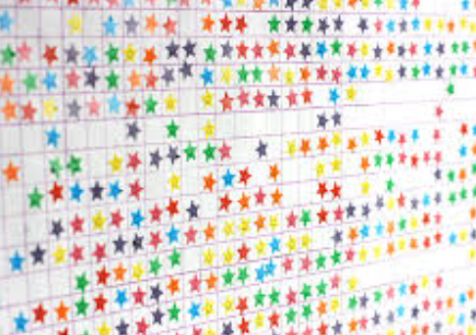
Reward Programs
Earn a reward contingent on meeting a specific behavioral goal
Reward must be motivating and varied
Goal must be attainable
Present it in a developmentally appropriate way
Track progress with the consumer
The goal should change as the consumer develops improved skills

Slide 29
Final Tips
Learn from each other. See what works sometimes and do more of that
Strategies will not work consistently
Make sure the expectations are reasonable
Focus on what the consumer is doing well
Listen to the consumer’s perspective

Slide 30
What are some successes you’ve had when using positive behavior supports?

Slide 31
Questions?

